Slide 1

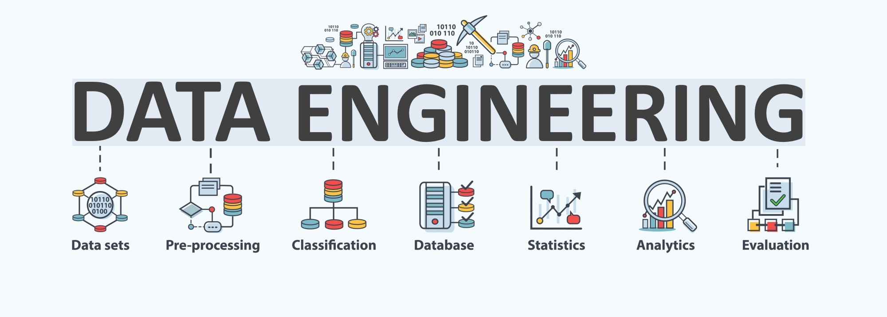
GROUP PROJECT 3
BY GROUP 3

Slide 2
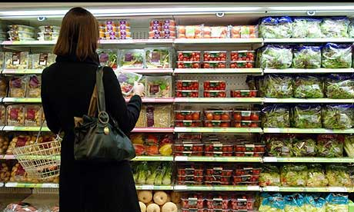
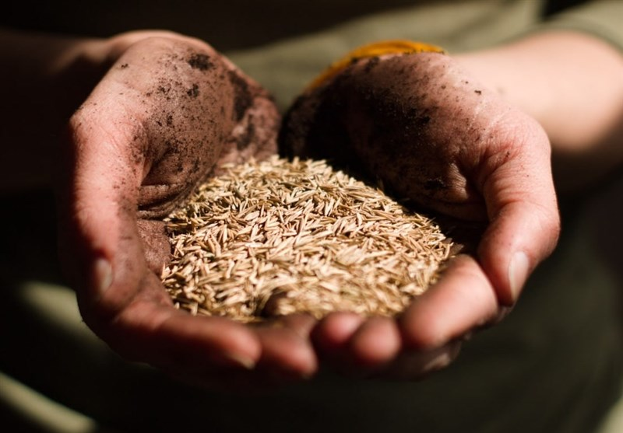
INTRODUCTION
In the current global landscape, fluctuations in food prices have become a significant area of concern. While domestic trends in the United States often receive the most attention, it is equally important to examine food pricing dynamics in other countries. This project seeks to support researchers in identifying notable shifts in global food prices and exploring potential correlations with international events that may contribute to these changes.

Slide 3




TECH STACK
01
01 - Data Analysis
Pandas, Numpy
02 - Database
02
SQLite, MongoDB
03
03 - Exploratory Analysis Tool
04
04 - Programming Language
Jupyter Notebook
Python
Notes:
© Copyright PresentationGO.com – The free PowerPoint and Google Slides template library

Slide 4
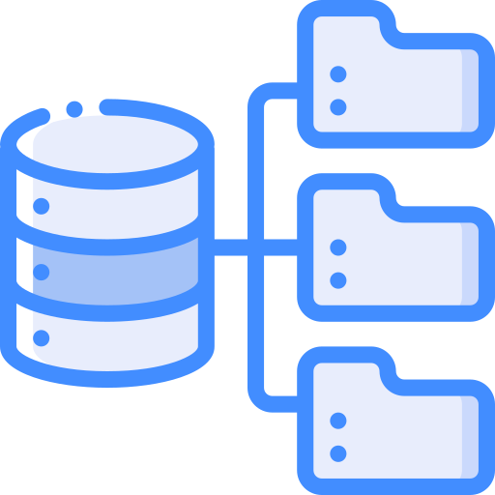


DATA PROCESS
EXTRACT
TRANSFORM
LOAD
Retrieves and verifies data from various sources
Processes and organizes extracted data into usable form
Moves transform data to a database

Slide 5
DATABASE EMPLOYED IN THIS STUDY
Data Collection:
Gathered datasets from international organizations World Bank, IMF)
Data Ingestion:
Imported raw data into storage systems using automated pipelines for scalability and consistency.
Data Cleaning & Preprocessing:
Removed duplicates, handled missing values, standardized formats, and normalized variables for uniformity.
Data Transformation:
Aggregated, filtered, and reformatted data to prepare it for analysis and visualization.
Storage & Management:
Structured and stored data in relational databases or cloud storage solutions for secure and efficient access.
Data Validation:
Verified accuracy and consistency to ensure data quality before analysis.
.

Slide 6
EXTRACT
01
TEXT HERE
02
TEXT HERE
03
TEXT HERE

Slide 7
TRANSFORM
TEXT HERE
TEXT HERE
TEXT HERE

Slide 8
LOAD
TEXT HERE
.

Slide 9

CONCLUSION
TEXT HERE

Slide 10
THANK YOU

